Slide 1

Executive Review
Vendor Performance &
Commercial Efficiency
Analysis Report
Prepared by
Purpose
Nithin Arisetty
Decision Support

Slide 2
Overview
Executive Summary
Strong Foundation
Capital Efficiency Gap
Overall performance demonstrates healthy profitability with robust top-line revenue and margins, establishing a solid commercial foundation.
$2.71M locked in slow-moving inventory, representing untapped working capital and elevated risk of obsolescence requiring strategic intervention.
Critical Risks Identified
Dual Profitability Models
High vendor concentration risk with top 10 vendors accounting for 65.7% of purchases, creating vulnerability to supply chain disruptions and pricing leverage imbalance.
Distinct commercial strategies emerge: high-volume moderate-margin vs. low-volume high-margin vendors, each presenting unique optimization opportunities.
Strategic Intent: This analysis provides leadership with data-driven insights to optimize pricing, vendor management, and inventory planning for enhanced profitability and operational resilience.

Slide 3
Foundation
Business Context & Objectives
Why This Matters
1
Identify Performance Extremes
Pinpoint top and underperforming vendors and brands
Effective vendor and inventory management is critical for sustaining profitability in retail and wholesale operations. Leadership requires visibility into key performance drivers to make informed strategic decisions.
2
Assess Concentration Risk
Evaluate vendor dependency and supply chain vulnerability
Which vendors drive majority revenue
Where capital is tied in slow inventory
3
Quantify Bulk Purchase Impact
How purchasing impacts unit costs
Measure how order volume affects unit costs and margins
Whether pricing aligns with goals
4
Highlight Inventory Inefficiencies
Identify unsold capital and slow-moving stock
5
Compare Profitability Models
Analyze margin structures across vendor segments

Slide 4
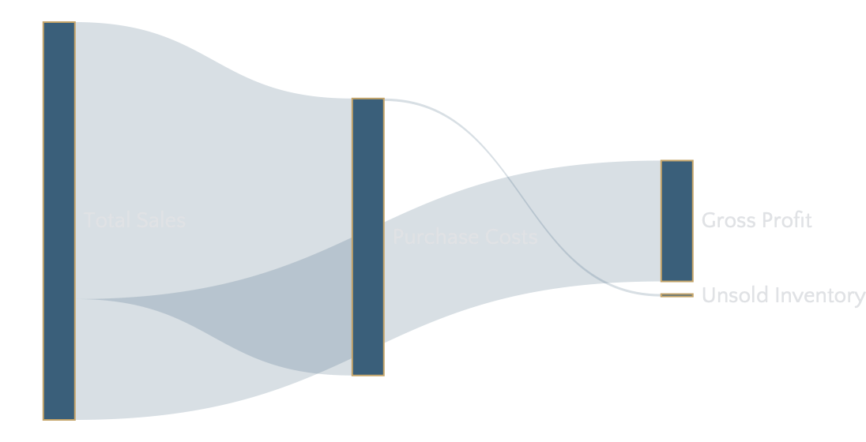
Financial Overview
Overall Commercial Performance
Total Sales
Purchase Value
Gross Profit
Avg Margin
Unsold Inventory
$441.41M
$307.34M
$134.07M
38.7%
$2.71M
Profitability Flow
Key Interpretations
Strong Top-Line Performance
Business demonstrates robust revenue generation with healthy profit margins, indicating effective market positioning.
Margin Dispersion Opportunity
Variability in margins across vendors suggests room for strategic pricing and procurement optimization.
Inventory Capital at Risk
$2.71M in unsold inventory represents working capital that could be deployed more efficiently.

Slide 5
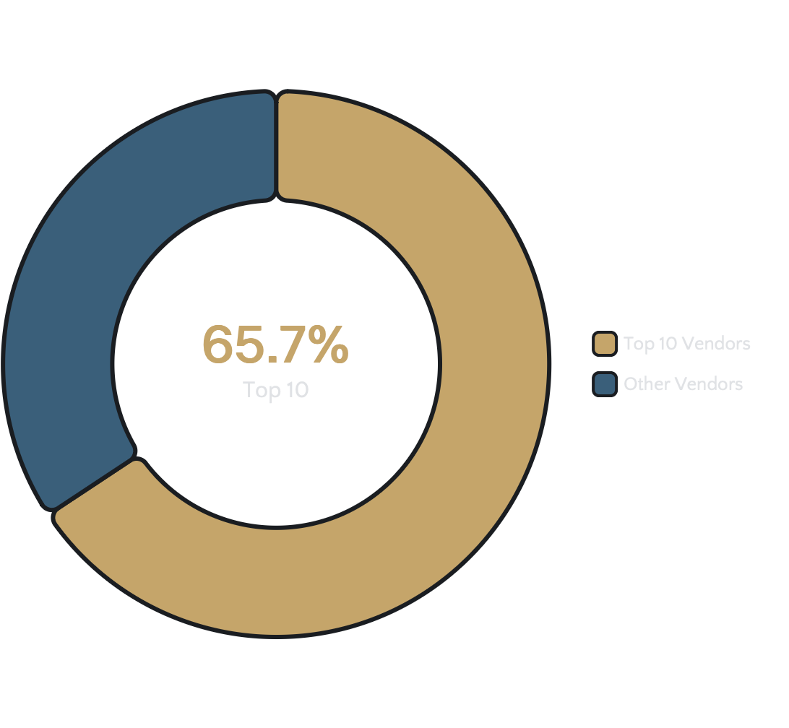
Risk Assessment
Vendor Concentration & Dependency
Purchase Distribution
65.7%
Critical Finding
Top 10 Vendors' Share
Nearly two-thirds of total purchases are concentrated among just 10 vendors, creating significant dependency risk.
Business Risk Factors
Supply Chain Disruptions
Any operational issue with a top vendor could immediately impact product availability
Pricing Leverage Imbalance
Limited negotiating power due to heavy reliance on few suppliers
Operational Risk Concentration
Single point of failure vulnerability across critical supply lines
Recommendation: Gradually diversify procurement by scaling reliable mid-tier vendors and using performance metrics to identify expansion candidates.

Slide 6
Performance Leaders
Top Vendors and Brand Performance
Leading Vendors
Top-Performing Brands
1
Diageo North America
Jack Daniel's No.7
Premium American Whiskey
2
Martignetti Companies
Tito's Handmade Vodka
Craft American Vodka
3
Pernod Ricard USA
Grey Goose Vodka
4
Premium French Vodka
Jim Beam Brands Company
Captain Morgan Spiced Rum
Leading Spiced Rum Brand
Performance Model
Top performers follow a high-volume, moderate-margin commercial model, prioritizing:
Scale and market penetration
Brand recognition and loyalty
Consistent consumer demand
Insight: These brands consistently outperform, reflecting strong consumer demand and established brand loyalty in the market.

Slide 7
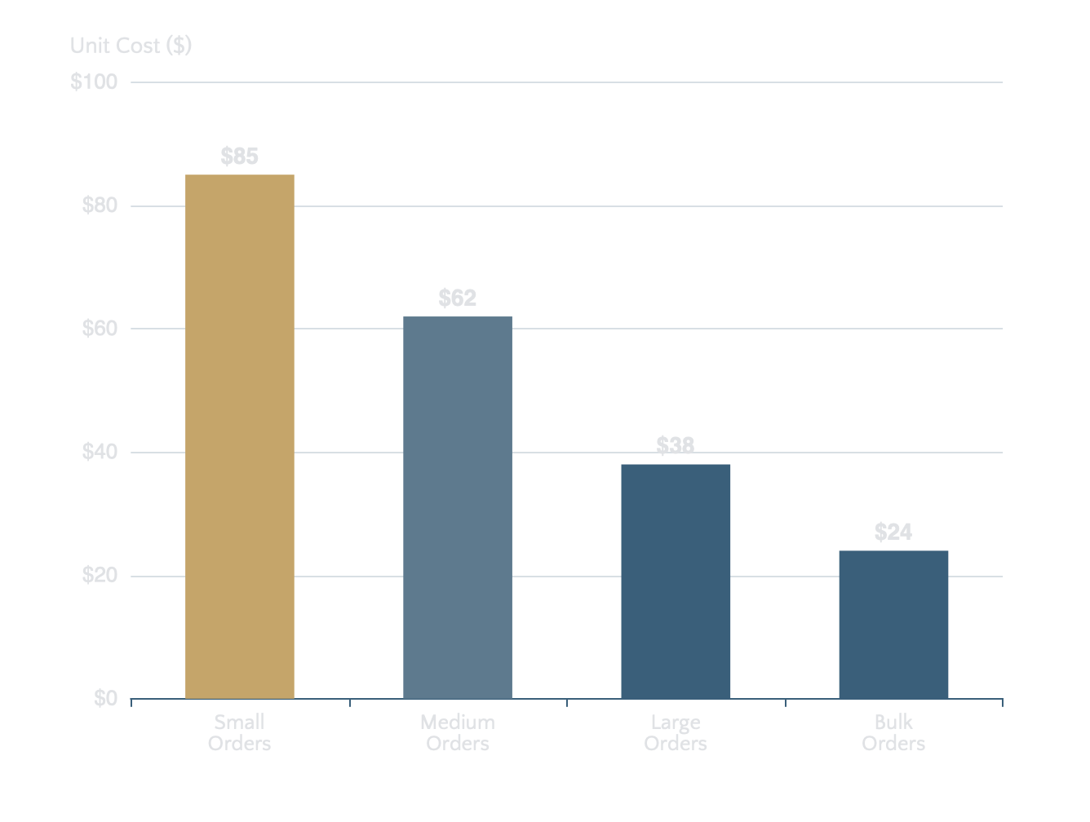
Procurement Strategy
Impact of Bulk Purchasing
Unit Cost vs. Order Size Relationship
72%
Cost Reduction
Large vs. Small Orders
Clear inverse relationship between order size and unit purchase cost demonstrates significant economies of scale.
Business Impact
Material Cost Efficiency
Bulk purchasing dramatically reduces per-unit costs
Margin Improvement
Higher volumes improve margins without price increases
Strategic Balance
Must balance cost savings with inventory risk
Recommendation: Align procurement with demand forecasts to maximize bulk pricing while controlling inventory exposure.

Slide 8
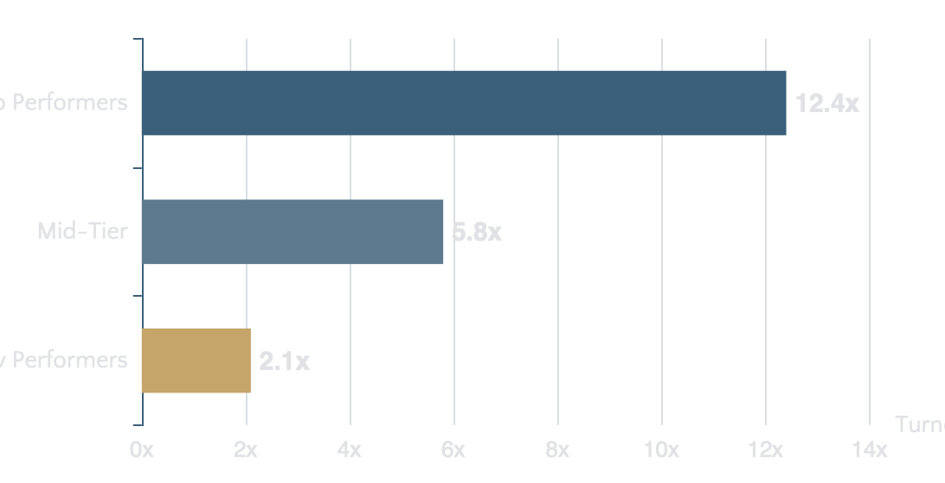
Capital Efficiency
Inventory Health & Low-Performing Vendors
Unsold Inventory Capital
Inventory Turnover Analysis
$2.71M
Represents 0.88% of total purchase value tied in slow-moving stock
Business Implications
Increased Storage Costs
Ongoing warehousing and handling expenses
Reduced Cash-Flow Efficiency
Working capital trapped in non-performing assets
Strategic Recommendations
1
Reassess reorder quantities for low-turnover vendors to prevent accumulation
Elevated Obsolescence Risk
Potential for discount-driven losses
2
Introduce clearance strategies to release tied-up capital quickly
3
Renegotiate terms with vendors showing persistent low turnover

Slide 9
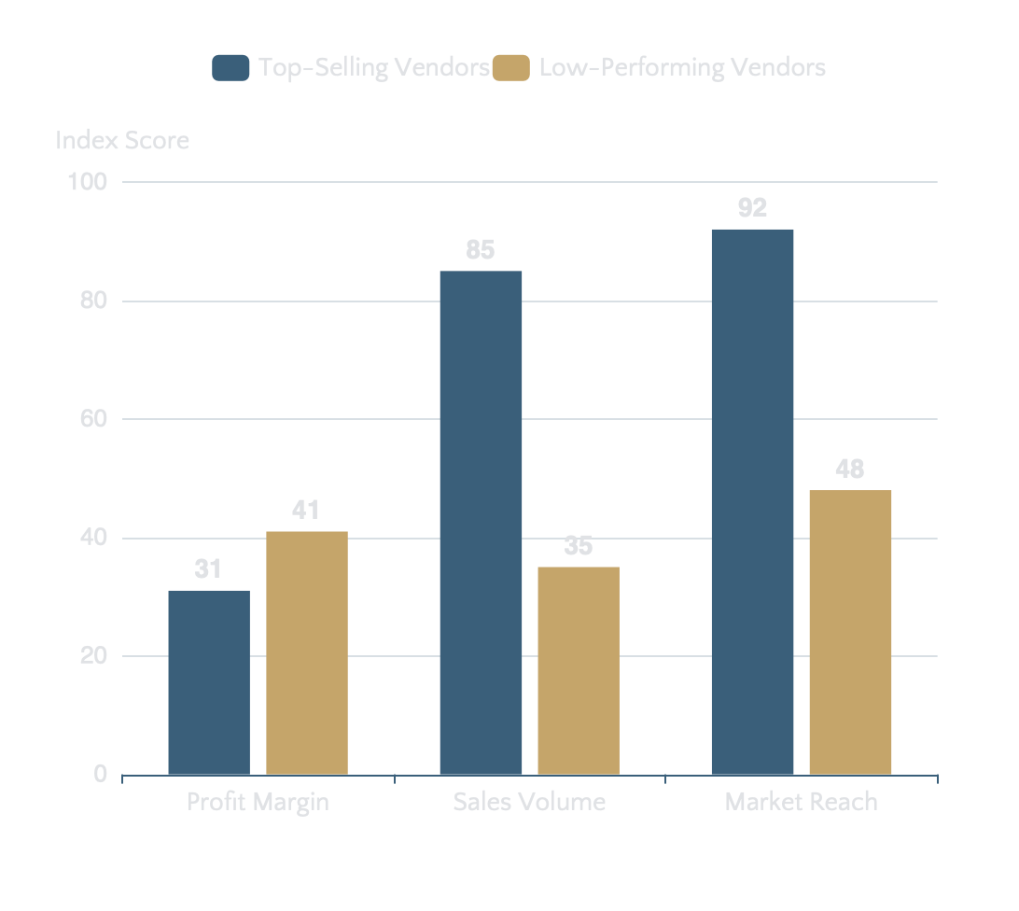
Segment Analysis
Profitability Comparison: Vendor Segments
Margin Structure by Segment
Top-Selling
Low-Performing
~31%
~41%
Mean Profit Margin
Mean Profit Margin
Two Distinct Commercial Models
High-Volume Model
Prioritizes market penetration and scale with moderate margins. Strong brand recognition drives consistent demand.
High-Margin Model
Operates at premium margins but lower volumes. Suggests pricing power or niche market positioning constraints.
Statistical Validation: Testing confirms significant difference in profit margins, validating structurally different strategies.

Slide 10
Action Plan
Strategic Recommendations
01
Scale High-Margin Vendors
02
Optimize Top Vendor Margins
03
Reduce Dependency Risk
Apply targeted promotions and pricing adjustments to increase sales volume for low-performing, high-margin vendors while preserving their premium margin structure.
Explore cost reductions, bundled offerings, or selective price optimization at scale to improve profitability without compromising market share.
Diversify sourcing by scaling reliable mid-tier vendors to improve supply chain resilience and strengthen negotiating leverage.
Volume Growth Opportunity
Margin Enhancement
Risk Mitigation
04
Leverage Bulk Procurement
05
Improve Inventory Efficiency
Expand bulk purchasing where demand is stable and inventory turnover is strong to capture the 72% cost reduction benefit.
Actively manage slow-moving stock through clearance, promotional, or renegotiation strategies to release the $2.71M tied-up capital.
Implementation Priority
Execute recommendations in parallel where possible, with immediate focus on inventory release and vendor diversification to maximize short-term impact.
Cost Efficiency
Cash Flow Optimization

Slide 11

Final Assessment
Commercial Strength with
Strategic Optimization Opportunities
Current Position
Growth Potential
The business is commercially strong with healthy profitability, robust revenue generation, and solid market positioning.
Targeted interventions across vendor management, pricing strategy, and inventory planning can unlock significant additional value.
By balancing volume growth with margin optimization and reducing dependency risks, the organization can enhance profitability while maintaining operational resilience.
Prepared by
This report provides leadership with a clear, data-backed foundation for strategic decision-making.
Nithin Arisetty

